Slide 1

The 90-Second Shield: How SOAR Automates Phishing Response
The Scenario
A phishing email lands in an employee's inbox with a malicious link disguised as a "password reset."

Slide 2
The 90-Second Automation Breakdown
Second 0–5: Detection & Trigger
Email Flagged
Alert Sent
Playbook Triggered
Email security gateway flags the email as phishing.
Sends alert to SOAR platform (e.g., Palo Alto XSOAR, Splunk SOAR).
SOAR playbook automatically triggers — no manual intervention needed.

Slide 3
Second 5–20: URL Analysis & Threat Intelligence
01
02
URL Extraction
VirusTotal Query
SOAR extracts the malicious URL from the email.
Queries VirusTotal → confirms the URL hosts malware.
03
04
MISP Threat Intelligence
Result
Checks MISP threat intelligence → identifies it as part of a known phishing campaign.
URL confirmed as malicious.

Slide 4
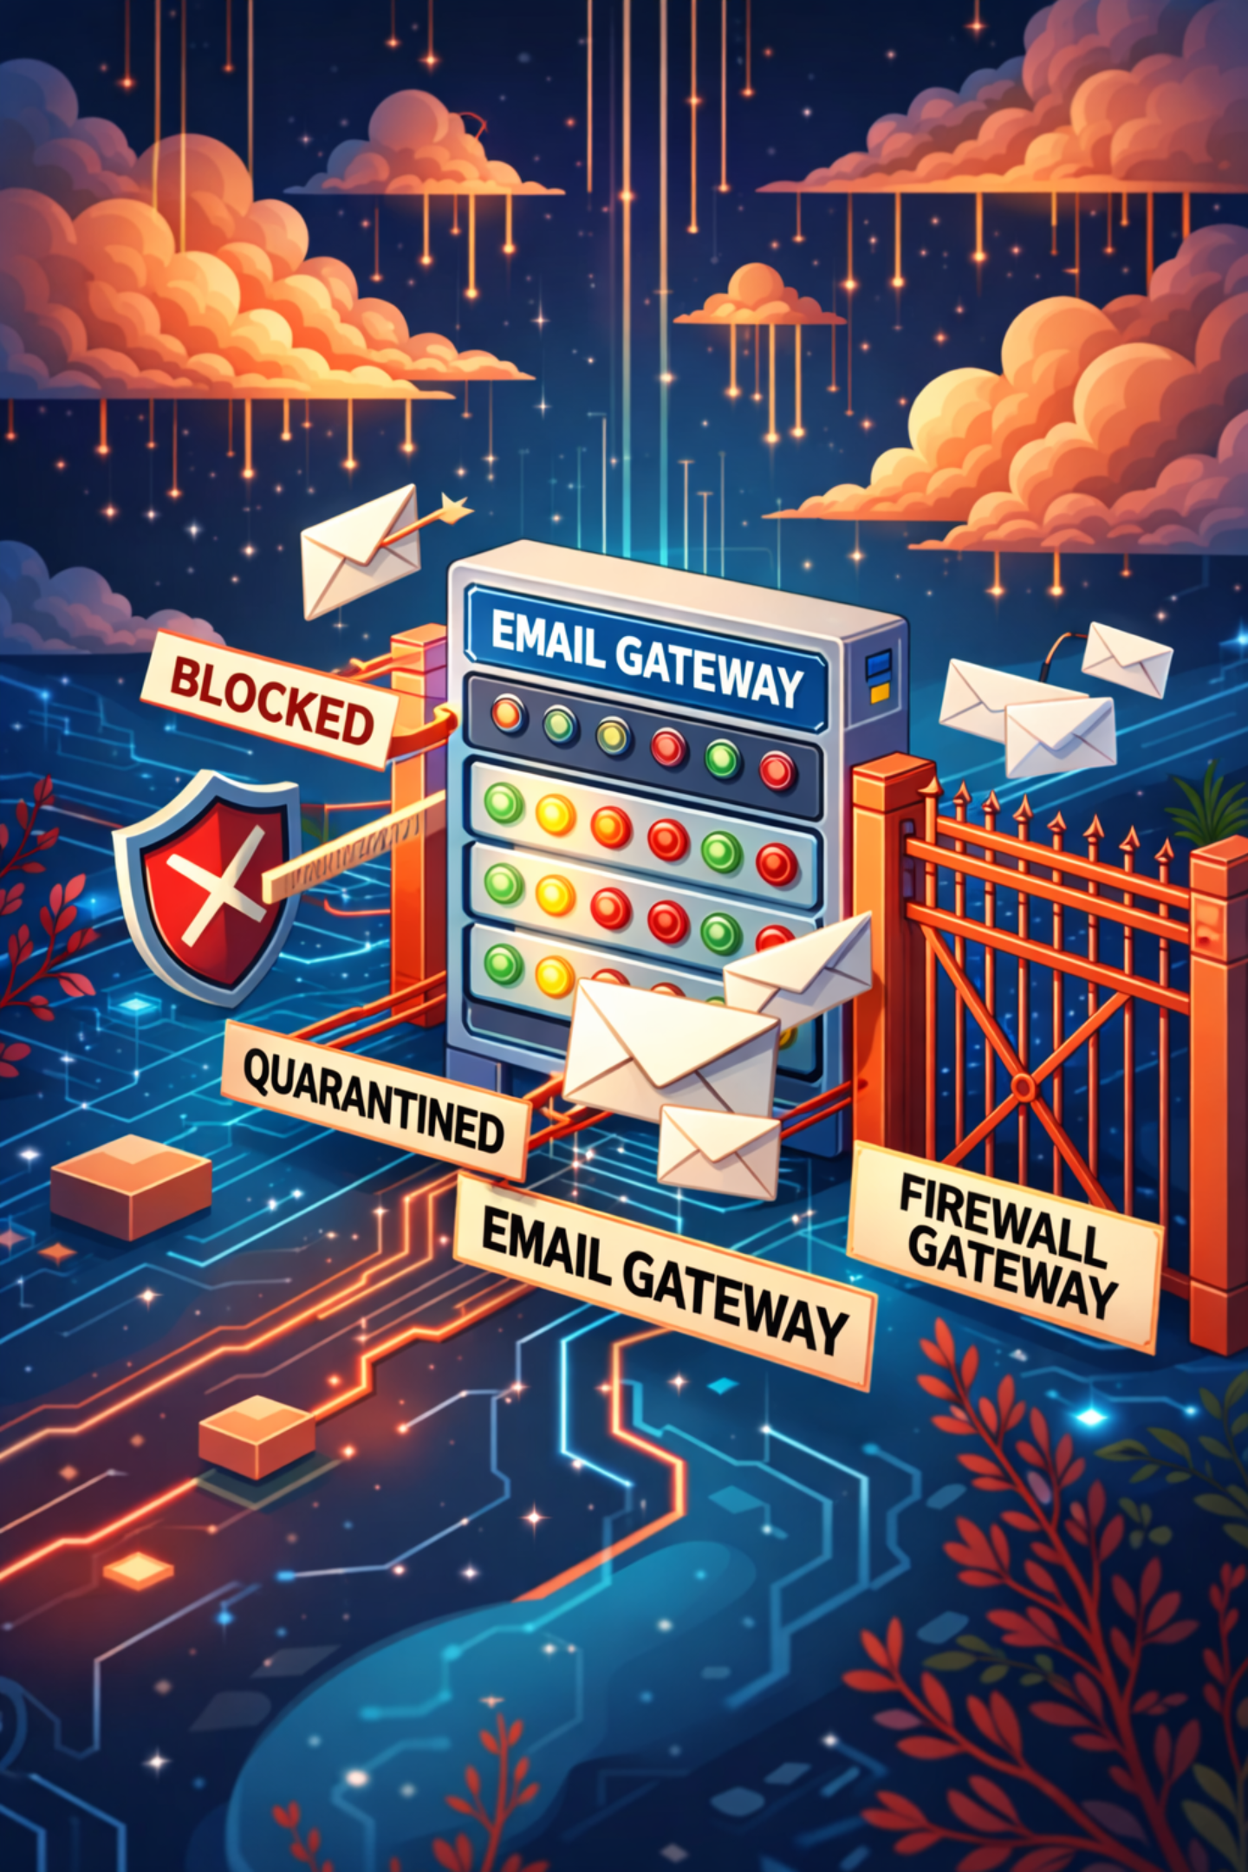

Second 20–35: Blocking & Containment
SOAR automatically:
🔒 Block URL
📧 Email Gateway
Blocks the URL in the firewall/proxy.
Adds it to the email gateway blocklist (prevents future emails with this link).
🗑️ Quarantine
Quarantines the email from the user's inbox.
Result: Threat neutralized before user clicks.

Slide 5
Second 35–50: Endpoint Isolation
If the email was already opened, SOAR:
EDR Monitoring
Isolation Commands
Triggers EDR to monitor the user's device.
Prepares isolation commands (if malware detected).
Result: Ready to respond if infection occurs.

Slide 6




Second 50–75: Notifications & Logging
SOAR sends alerts to:
SOC Team
User
SOC team via Slack/Teams.
User via email (warning about phishing attempt).
IT/Security Leadership
Ticket Created
IT/Security leadership (summary report).
Creates a ticket in the ticketing system (TheHive, ServiceNow) with all details.

Slide 7
Second 75–90: Post-Incident Actions
SOAR Logs
Follow-Up Actions
Who received the email.
When it was detected.
What actions were taken.
Triggers security awareness training for affected users.
Updates threat intelligence feeds with new IOCs.

Slide 8
What Would Take 2–3 Hours Manually
Task
Manual Time
SOAR Time
Receive alert
5 min
0 min
Check threat intel
15 min
5 min
Block URL in firewall
10 min
5 min
Block in email gateway
10 min
5 min
Notify team
10 min
5 min
Create ticket
15 min
5 min
Isolate endpoint
20 min
10 min
TOTAL
85 minutes
40 seconds

Slide 9
Behind the Scenes
START: Phishing Email Detected
↓
EXTRACT: Malicious URL
↓
QUERY: VirusTotal API → Is URL malicious?
↓
QUERY: MISP → Known threat actor?
↓
IF malicious:
├─ Block URL in Firewall (Palo Alto API)
├─ Block in Email Gateway (Proofpoint API)
├─ Quarantine Email
├─ Trigger EDR Monitoring (CrowdStrike API)
├─ Send Slack Alert to SOC
├─ Send Email to User
├─ Create Ticket in ServiceNow
└─ Log to SIEM
↓
END: Incident Contained

Slide 10





Why SOAR Wins
Speed
Consistency
Scalability
90 seconds vs. 2–3 hours manually.
Same response every time — no human error.
Handles 1,000 phishing emails simultaneously.
Analyst Focus
Audit Trail
Frees up SOC team for complex investigations.
Complete documentation for compliance.

Slide 11
Before SOAR
50 phishing emails/day → 5–10 reach users → 2–3 infections.
After SOAR
50 phishing emails/day → 0–1 reach users → 0 infections.

